Slide 1
^{Top Youtube channels}
Team members
LeADEr: saranya. S
Akilamani. C
Santhiya. P
Mini piriya. M

Slide 2
Introduction
A subscriber to a channel on the video-sharing YouTube is a user who has chosen
to receive the channel's content by clicking on that channel's "Subscribe" button,
and each user's subscription feed consists of videos published by channels to which
the user is subscribed. The ability to subscribe to users was introduced in October
2005. YouTube began publishing a list of its most-subscribed channels in April 2006.
An early archive of the list dates to May 2006.

Slide 3
Purpose
Life Purpose:
This refers to an individual‘s reason for being, their overarching goal or mission in life. It often involves a sense of meaning and fulfillment.
Business Purpose:
In the context of a company or organization, purpose can refer to its reason for existence beyond just making a profit. It often involves a commitment to making a positive impact on society or the environment.
Goal or Intent:
Purpose can also refer to the specific objective or intention behind a particular action or decision.If you have a specific context in mind or need more information on a particular aspect of "purpose," please provide additional details, and I'd be happy to provide more specific information.

Slide 4
Problem statement & deaign thinking
Problem Statement in Design Thinking:
In the design thinking process, defining a clear problem statement is often the first step. This statement should focus on the needs and experiences of the end-users or customers. It sets the stage for the entire design process.
Design Thinking Approach:
Design thinking is a human-centered approach to problem-solving. It typically involves the following key stages. Empathize Understand the needs, feelings, and challenges of the people who are experiencing the problem.
Create a clear and concise problem statement based on what you‘ve learned during the empathize stage. Generate a wide range of creative solutions to the defined problem. Build tangible representations of your ideas to test and refine them. Gather feedback from users and iterate on your solutions.The problem statement is crucial in guiding the design thinking process.
It helps ensure that the solutions developed are addressing the real needs and pain points of the users.For example, if you were working on a design thinking project for a company's customer service department, your problem statement might be: "How might we improve the customer service experience for our clients who are facing long wait times and difficulty in reaching a representative"Design thinking is a flexible and iterative approach that encourages innovation and user-centered solutions, making it a valuable method for solving a wide range of problems.

Slide 5
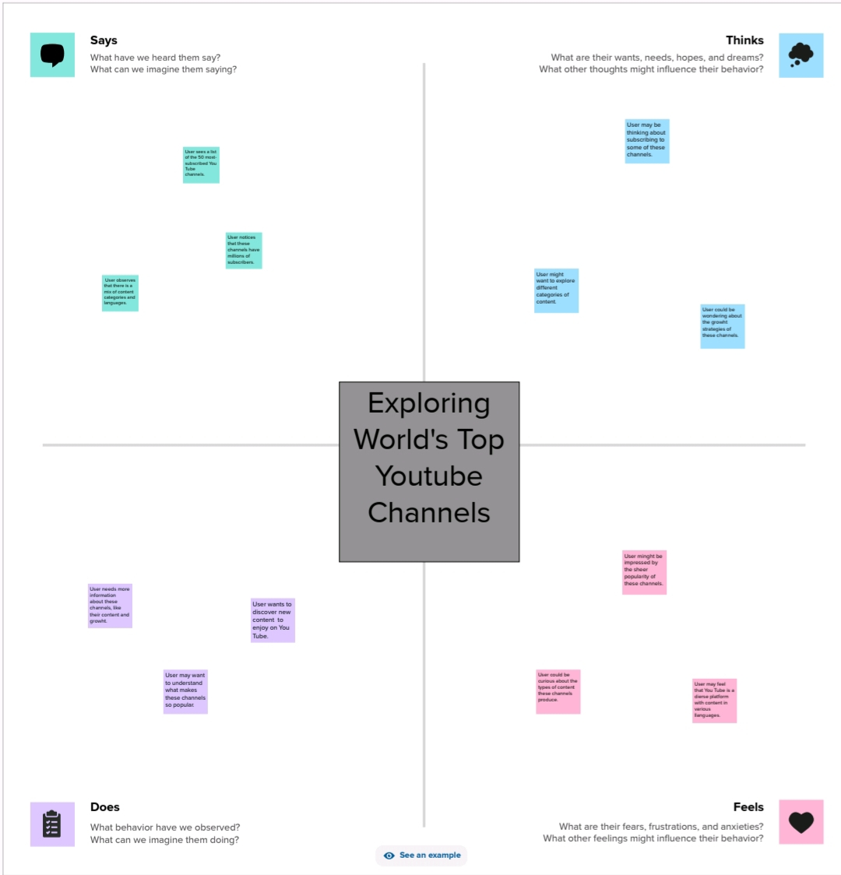
Empathy map :

Slide 6
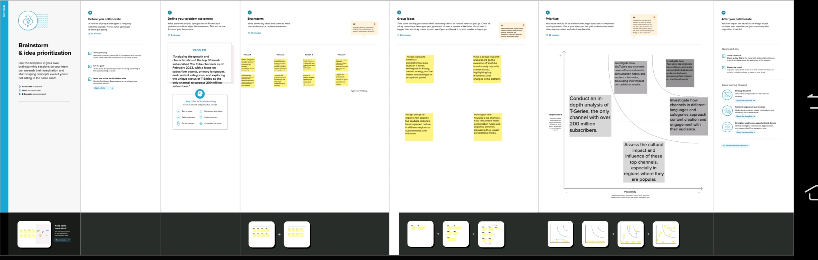
Brainstorm Map :

Slide 7
Advantages
User-Centered Approach:
Design thinking places a strong emphasis on understanding the needs and perspectives of the end-users, resulting in solutions that are more likely to meet their requirements and expectations.
Creativity and Innovation:
The ideation phase of design thinking encourages the generation of a wide range of creative ideas. This can lead to innovative solutions that may not have been apparent through traditional problem-solving methods.
Iterative Process:
Design thinking is an iterative process, allowing for continuous testing, feedback, and improvement of solutions. This reduces the risk of developing a solution that doesn't work well in practice.
Interdisciplinary Collaboration:
It often involves interdisciplinary teams, which can bring together people with diverse skills, knowledge, and perspectives. This collaboration can lead to more holistic and effective solutions.
Practical Prototyping:
Creating prototypes in the design thinking process allows for early testing and validation of ideas, helping to identify and address potential issues before a full-scale implementation.
Improved Decision-Making:
By prioritizing empathy and understanding of user needs, design thinking helps in making informed and user-driven decisions, reducing the chances of making assumptions that can lead to poor solutions.

Slide 8
Disadvantages
Inappropriate Content:
YouTube hosts a wide range of content, and not all of it is suitable for all audiences. Inappropriate or offensive content can be easily accessible, which is a concern for parents and guardians.
Copyright Issues:
Users often upload copyrighted material without permission, which can lead to legal issues. YouTube's Content ID system tries to address this, but it's not always foolproof.
Concerns:
Sharing personal information or data on YouTube can lead to privacy issues. Users need to be cautious about what they reveal online.
Online Harassment and Trolling:
YouTube comments and social interactions can sometimes devolve into harassment and trolling, leading to a negative experience for content creators and viewers.
Addictive Nature:
The platform is designed to keep users engaged, which can lead to excessive screen time and potential addiction.
Misinformation:
Like other social media, YouTube is susceptible to the spread of false or misleading information.

Slide 9
Applications
Entertainment:
YouTube is a platform for entertainment, offering a vast library of videos including music videos, movies, TV shows, comedy sketches, and more.
Education:
Many educators and organizations use YouTube to share educational content, tutorials, and lectures on a variety of subjects.
Information and News:
News outlets and individual reporters often post news updates and reports on YouTube, making it a source for up-to-date information.
Learning and Skill Development:
YouTube is a valuable resource for learning new skills. You can find tutorials on cooking, DIY projects, coding, and more.
Music Discovery:
It's a popular platform for discovering new music, with many musicians and record labels uploading their songs and music videos.
Gaming:
Gamers use YouTube to share gameplay videos, walkthroughs, and reviews. There's also a large gaming community on the platform.

Slide 10
Conclusion
In conclusion, YouTube is a multifaceted platform that serves a wide array of purposes in our digital age. It has evolved from a simple video-sharing website to a global powerhouse with diverse applications. Whether you're seeking entertainment, education, information, or connection, YouTube provides a platform for it all. From music and gaming to tutorials, vlogs, and beyond, YouTube has reshaped the way we consume and share content. However, it's essential for users to be aware of the platform's advantages and disadvantages and to use it responsibly to make the most of what it has to offer. As YouTube continues to evolve, it remains a dynamic and influential force in the digital landscape.

Slide 11
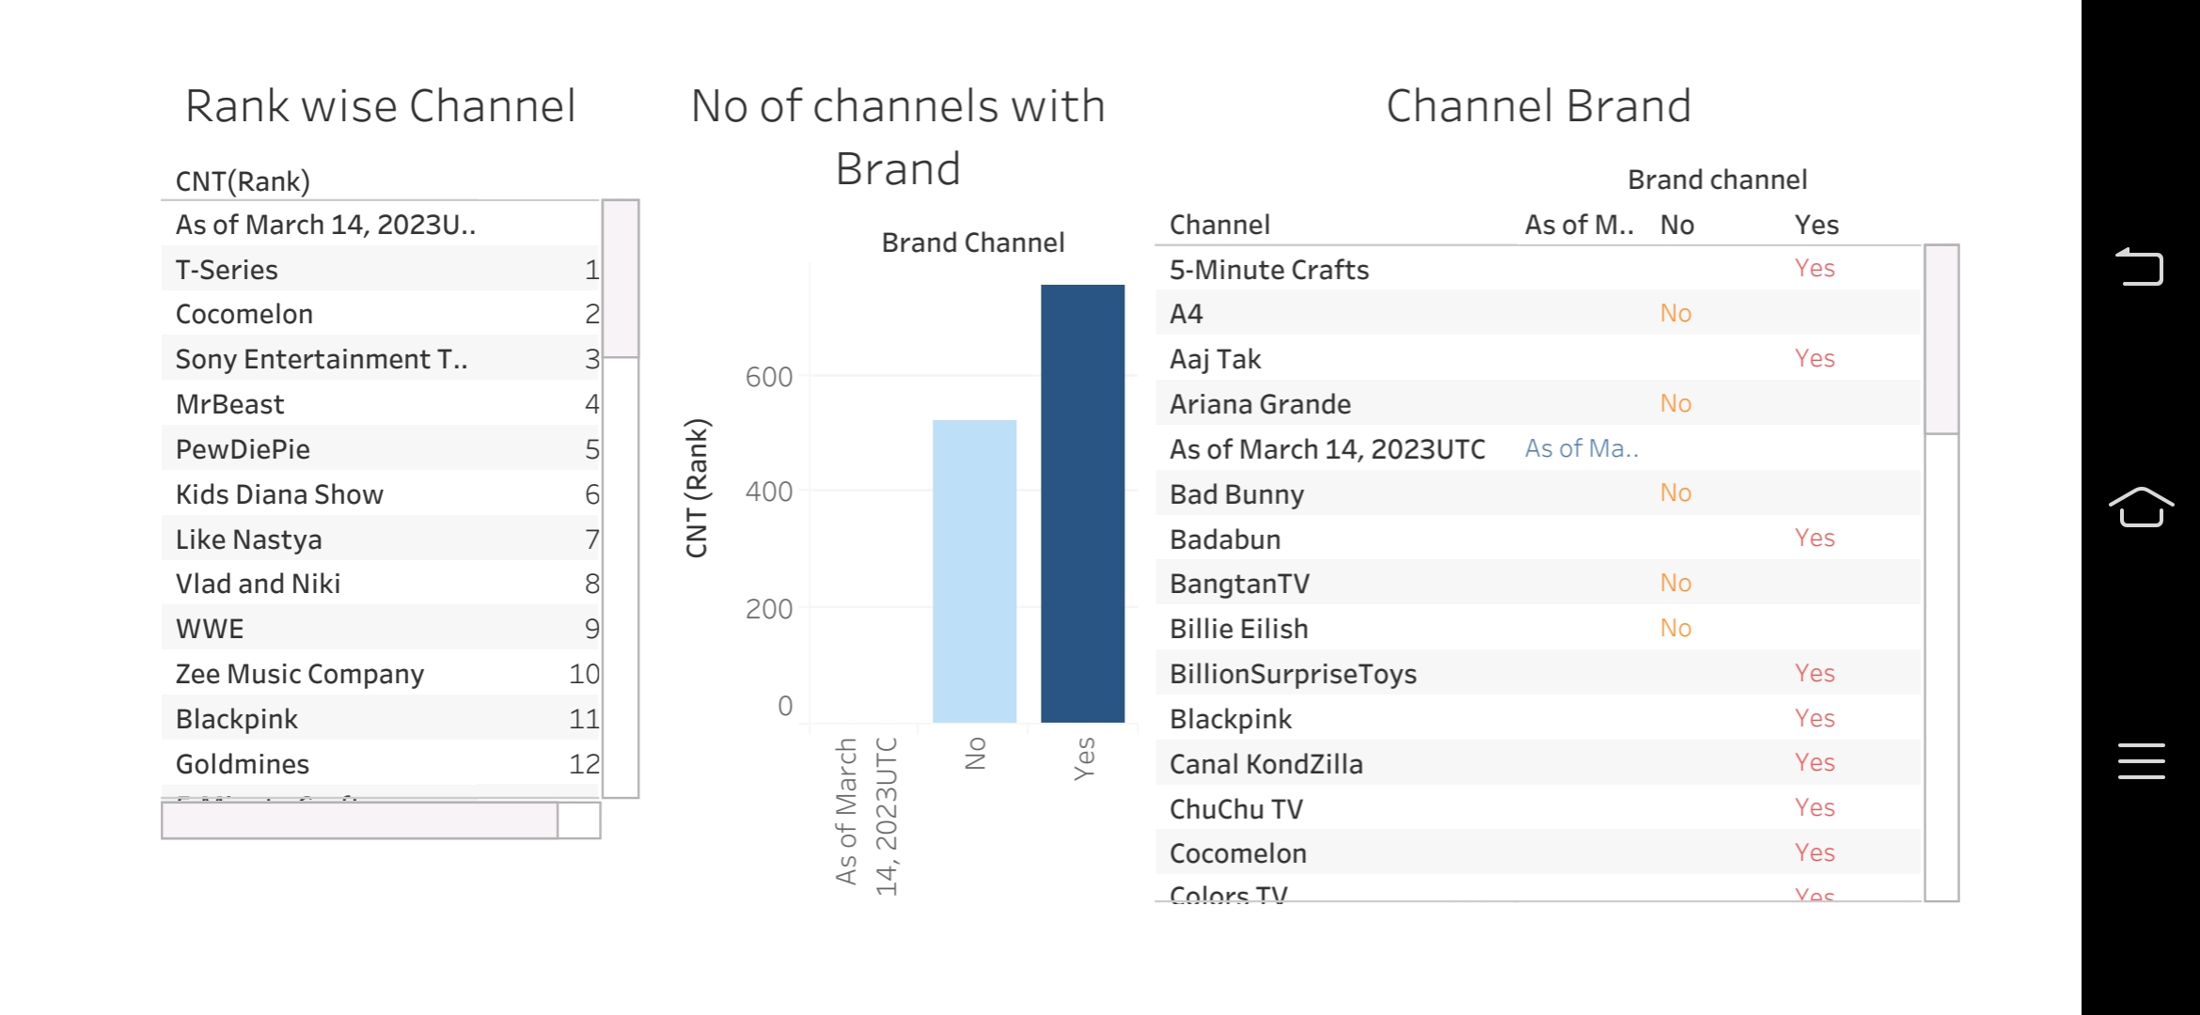
Results

Slide 12
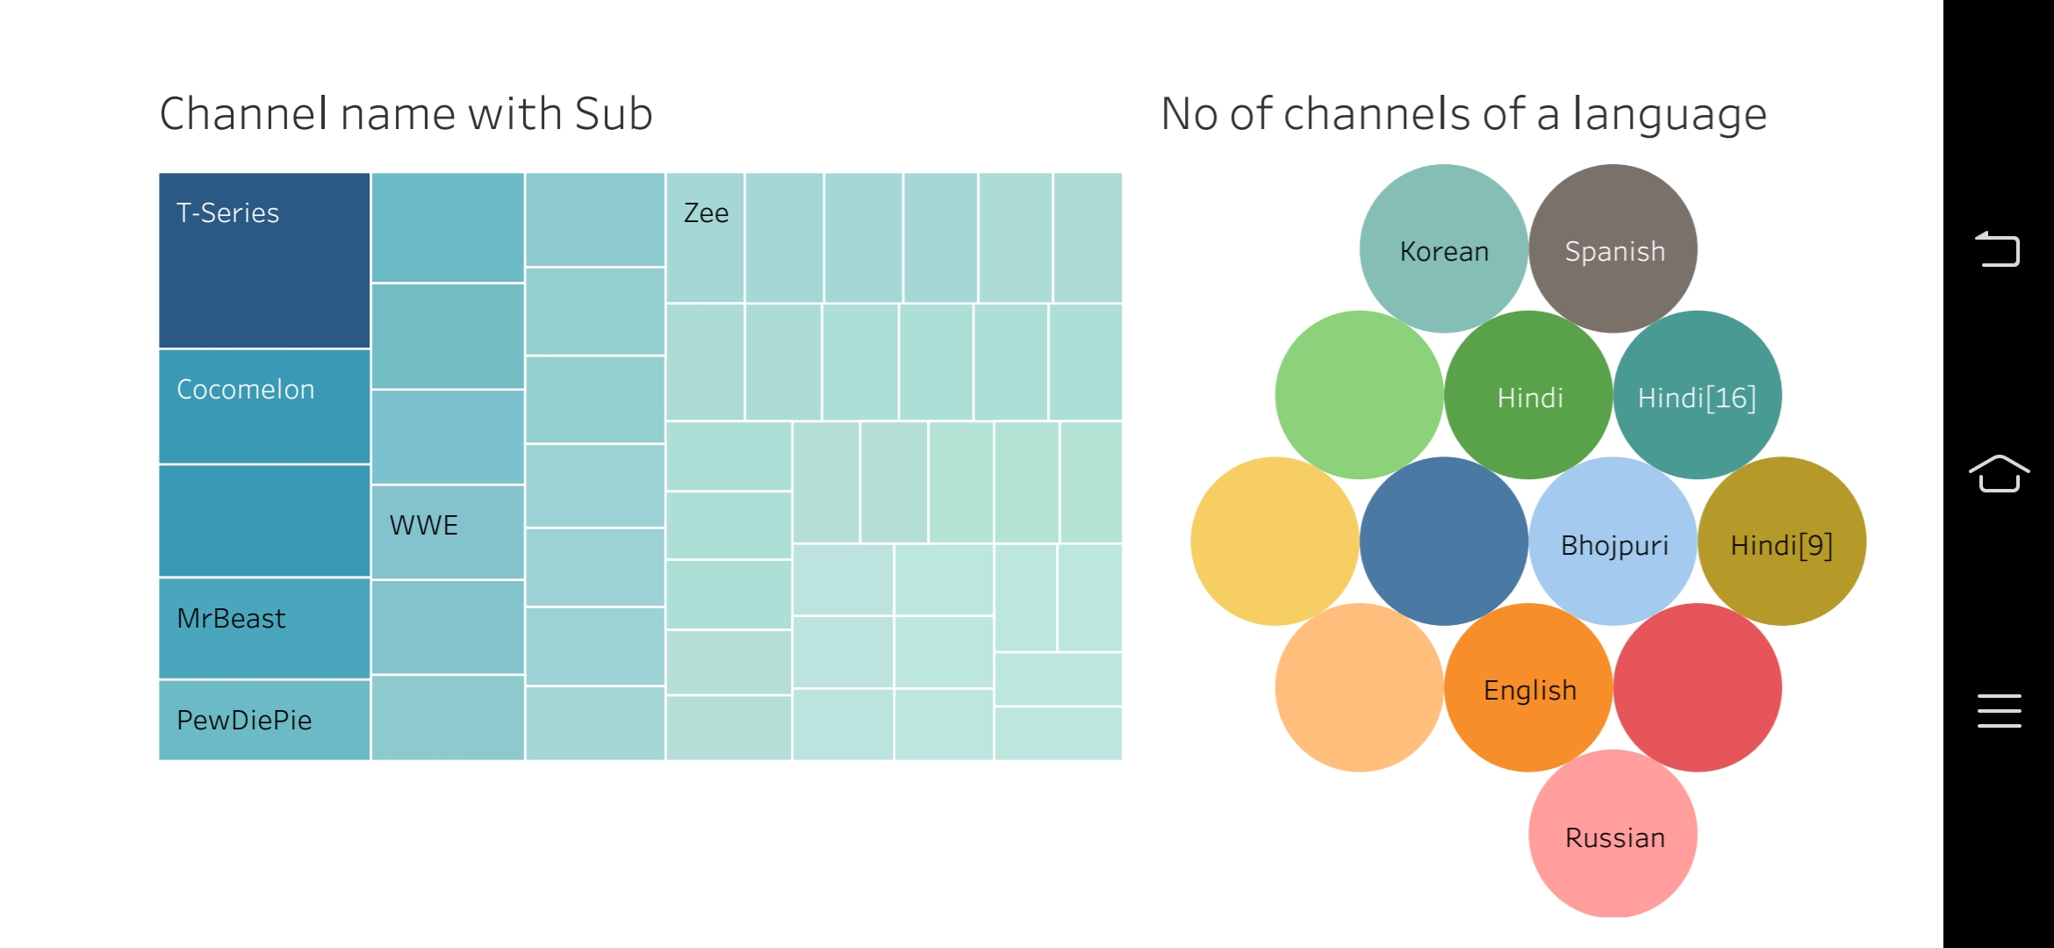

Slide 13
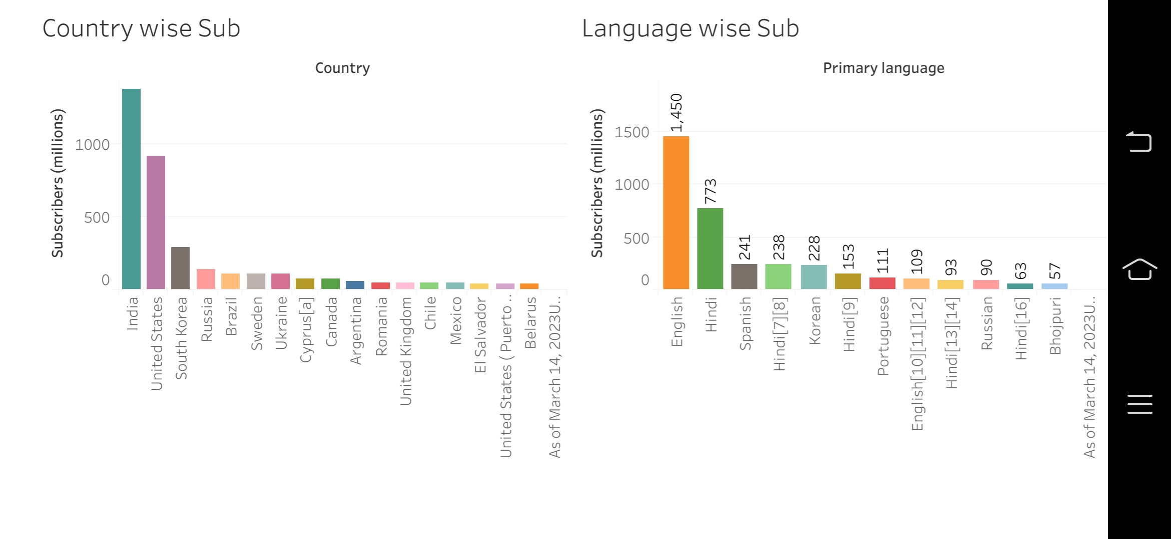

Slide 14
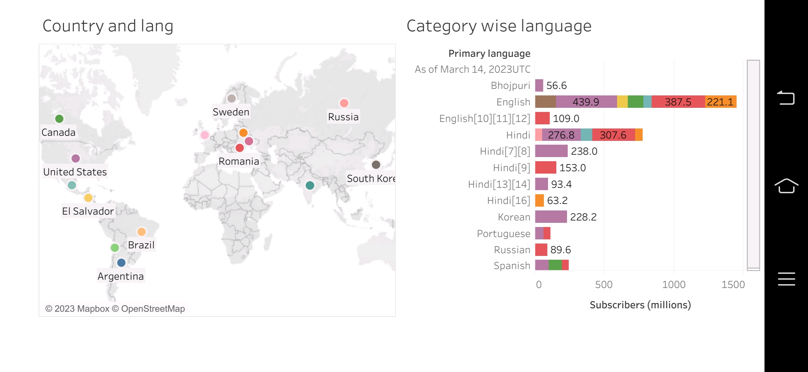

Slide 15
Thank you

